Slide 1


Slide 2
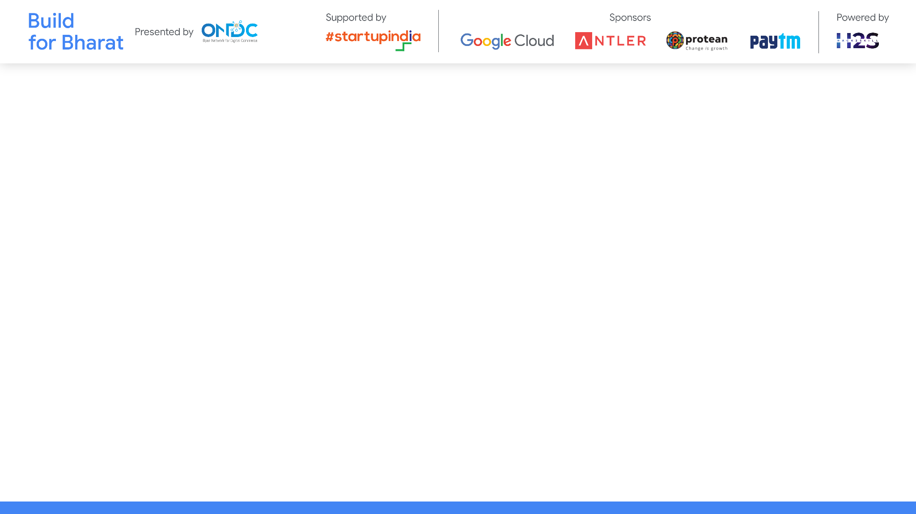
PROJECT NAME : Price optimization engine
Team Leader Name : K. Mahendra sunny goud
Team Member Names : A . Sreeram sagar
: R. Sampath kumar
Problem Statement Category: Foundational or Scalable Solution
*You can make a copy of the slides. Do not change the template branding.

Slide 3
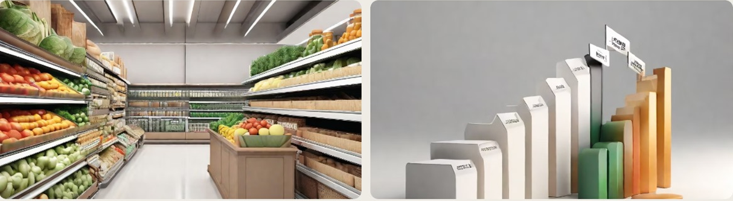
PROBLEM STATEMENT
Transforming Pricing Strategies
The grocery retail industry needs a transformative approach to pricing strategies, moving away from traditional methods and embracing agile, intuitive, and data-driven approaches.
*You can make a copy of the slides. Do not change the template branding.

Slide 4
PROBLEM STATEMENT
Best Pricing Recommendations
The aim is to provide sellers with the best pricing recommendations for products or services, optimizing conversions on buyer applications.
Limited Duration
The recommended prices should be valid for a limited duration, allowing sellers to adapt to market dynamics and changing customer preferences.
Impacting Customer Satisfaction
Focus on products and categories with margin for cost changes that impact the customer, ensuring a balance between profitability and customer satisfaction.
*You can make a copy of the slides. Do not change the template branding.

Slide 5
OBJECTIVES
Ever-Shifting Consumer Demands
Stay updated on consumer preferences and trends to align pricing strategies with customer expectations.
Conduct market research and analyze customer feedback to understand pricing sensitivities.
Dynamics of Product Shelf Life
Consider the perishability and expiration dates of products when setting prices.
Implement dynamic pricing strategies to optimize revenue for products with limited shelf life
Real-Time Inventory Management
• Monitor inventory levels in real- time to adjust pricing based on supply and demand.
• Implement automated systems to optimize pricing based on inventory availability.
*You can make a copy of the slides. Do not change the template branding.

Slide 6
METHODOLOGIES
Briefly, price optimization uses data analysis techniques to pursue two main objectives:
Understanding how customers will react to different pricing strategies for products and services, i.e., understanding the elasticity of the demand.
2.Finding the best prices for a given company, considering its goals.

Slide 7
Price optimization techniques can help retailers evaluate the potential impact of sales promotions or estimate the right price for each product if they want to sell it in a certain period of time.
Current state-of-the-art techniques in price optimization allow retailers to consider factors such as:
Competition
Weather
Season
Special events / holidays
Macroeconomic variables
Operating costs
Warehouse information

Slide 8
Application Features
The price optimization engine offers a range of powerful features to help grocery retailers implement agile, intuitive, and data-driven pricing strategies.
Key Features
Feature | Description
Inventory-based Pricing | Provides pricing recommendations based on inventory levels to ensure optimal stock management and reduce waste.
Terms of Trade | Takes into account negotiated terms of trade with suppliers to optimize pricing and maximize profit margins.
Margin Optimization | Uses advanced algorithms to determine the ideal pricing that maximizes profit margins while remaining competitive in the market.
Market Price Analysis | Leverages real-time market data to analyze competitor prices and adjust pricing strategies accordingly.

Slide 9
Solution Overview
The price optimization engine is a powerful tool that provides sellers with pricing recommendations for their products or services. It is designed to be agile, intuitive, and data-driven, enabling sellers to make informed pricing decisions in real-time.
Agile
The solution is built with agility in mind, allowing sellers to quickly adapt their prices to changing market conditions. It takes into account factors such as consumer demands, product shelf life, and inventory levels to provide dynamic pricing recommendations.
*You can make a copy of the slides. Do not change the template branding.

Slide 10
Intuitive
The user interface of the application is intuitive and user-friendly, making it easy for sellers to navigate and understand the pricing recommendations. It provides clear visualizations and actionable insights to help sellers optimize their pricing strategies.
Data-Driven
The price optimization engine leverages advanced data analytics and machine learning algorithms to analyze large volumes of data. It considers historical sales data, competitor prices, market trends, and customer preferences to generate accurate and personalized pricing recommendations.
*You can make a copy of the slides. Do not change the template branding.

Slide 11


